Slide 1
Multinational Corporate Finance
Nature of multinational corporations
Reason for companies going global
Multinational versus domestic financial management
Exchange rate Quotation
Cross Rates
Interbank foreign currency quotations
Trading in foreign exchange rate
Spot rate and Forward rate
Interest rate parity
Purchasing Power Parity
Inflation, Interest Rates and Exchange Rates
International Money and Capital Market
International Capital Budgeting
International Capital Structure

Slide 2
Nature of Multinational Corporation
Multinational corporation, global corporation, multinational company are used synonymously
Company that operates at least in two or more than in two countries
Management, ownership and control spread over the countries
Business organization that transcend political boundaries
Example: Coca-cola, IBM, Sony, Honda, Nestle, Pepsi, Unilever etc.
Nature/ characteristics:
Big Size
Monopoly/ oligopolistic Power
Mass Production and Distribution
Multiple Currencies
Advance Technology
Centralized Control
Global Area of Operation

Slide 3
Reasons for Companies Going Global
To expand market
To seek basic resources
To seek new technology
To increase efficiency
To avoid political instability
To avoid regulatory burden
To diversify the risk
To reduce the cost

Slide 4
Multinational Versus Domestic Financial Management
Different Currencies
Economic and Regulatory Framework
Language
Culture
Political Risk
Role of Government

Slide 5
Exchange Rate Quotations
NRB quotes foreign exchange rate daily
Exchange rate as of 24th Sep 2022
Currency | Unit | Buy | Sell
USD (U.S. Dollar) | 1 | 129.3 | 129.9
EUR (European Euro) | 1 | 126.2 | 126.8
GBP (UK Pound Sterling) | 1 | 143.7 | 144.3
CHF (Swiss Franc) | 1 | 131.9 | 132.5
AUD (Australian Dollar) | 1 | 85.1 | 85.49
CAD (Canadian Dollar) | 1 | 95.64 | 96.08
SGD (Singapore Dollar) | 1 | 90.75 | 91.17
JPY (Japanese Yen) | 10 | 9.05 | 9.1
CNY (Chinese Yuan) | 1 | 18.16 | 18.24
SAR (Saudi Arabian Riyal) | 1 | 34.39 | 34.55
QAR (Qatari Riyal) | 1 | 35.38 | 35.55
THB (Thai Baht) | 1 | 3.45 | 3.46
AED (UAE Dirham) | 1 | 35.2 | 35.36
MYR (Malaysian Ringgit) | 1 | 28.24 | 28.37
KRW (South Korean Won) | 100 | 9.13 | 9.17

Slide 6
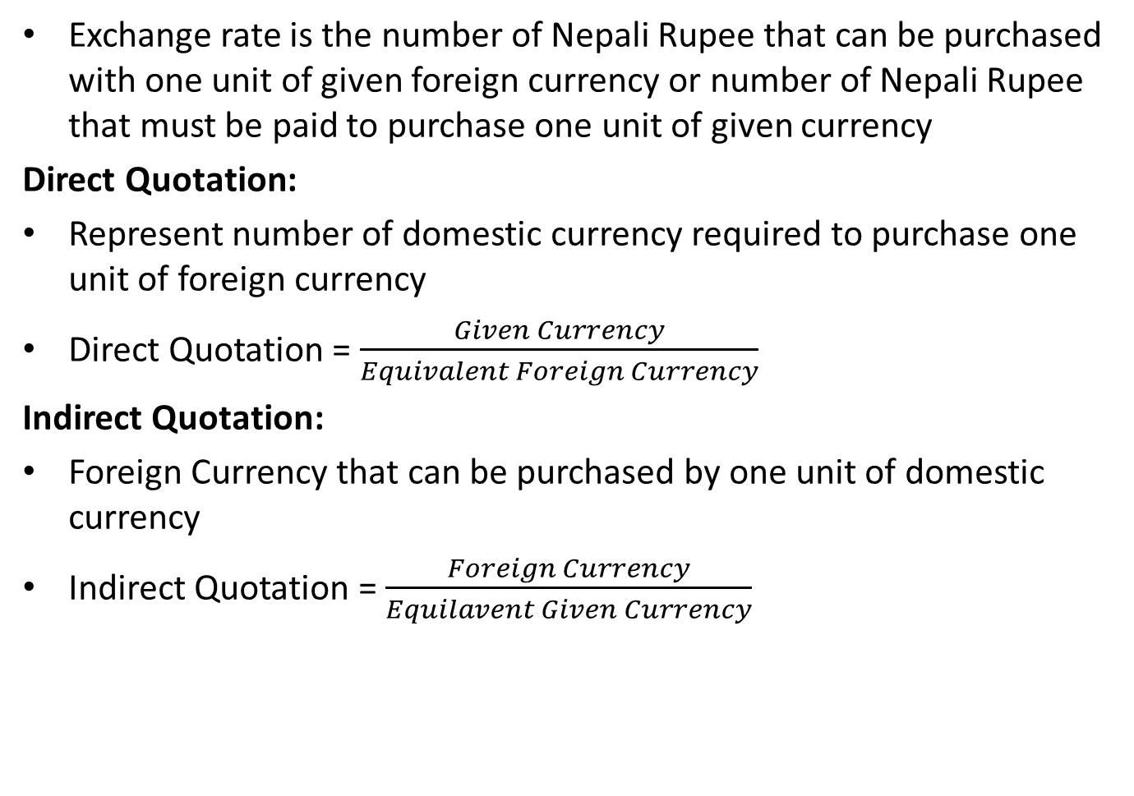
Exchange Rate Quotations
Exchange rate is the number of Nepali Rupee that can be purchased with one unit of given foreign currency or number of Nepali Rupee that must be paid to purchase one unit of given currency
Direct Quotation:
Represent number of domestic currency required to purchase one unit of foreign currency
Direct Quotation = $\frac{Given Currency}{Equivalent Foreign Currency}$
Indirect Quotation:
Foreign Currency that can be purchased by one unit of domestic currency
Indirect Quotation = $\frac{Foreign Currency}{Equilavent Given Currency}$

Slide 7
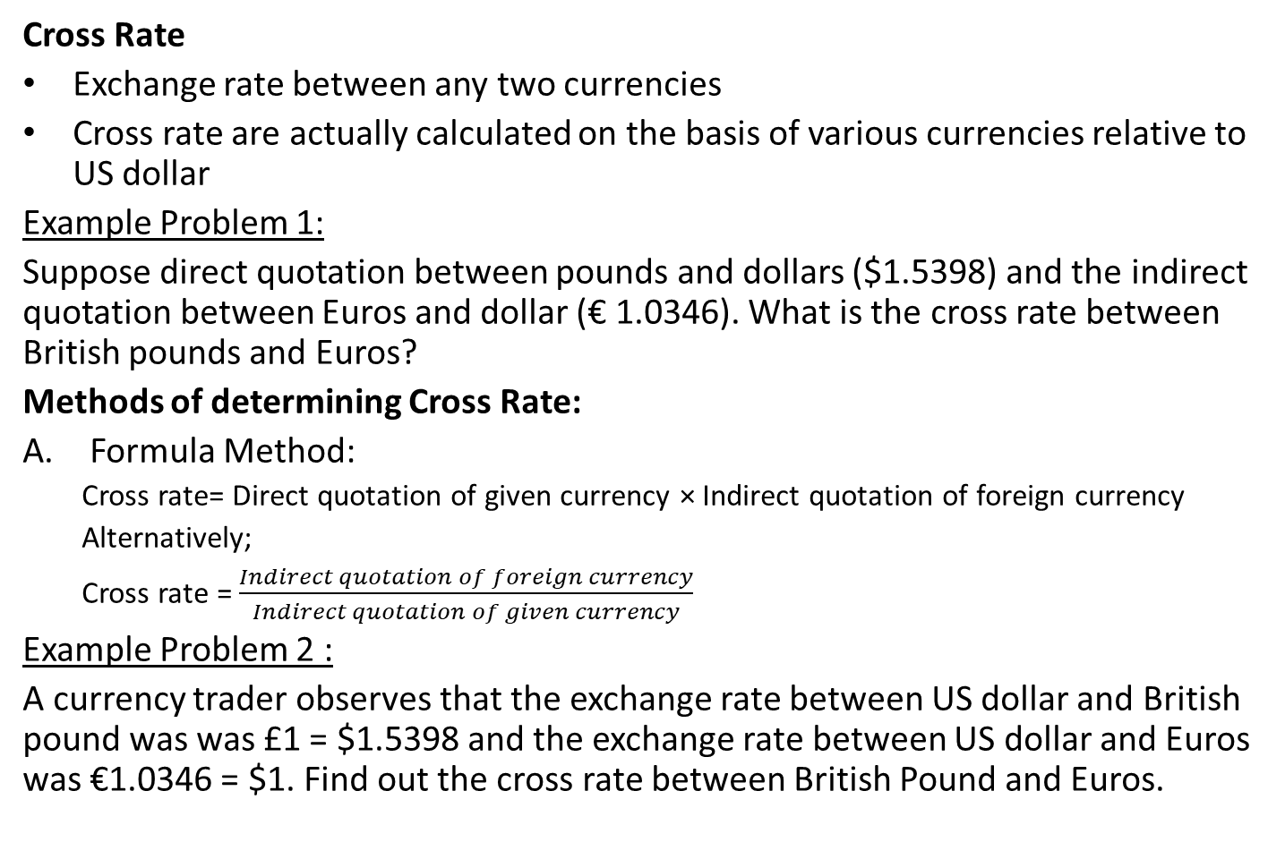
Exchange Rate Quotations
Cross Rate
Exchange rate between any two currencies
Cross rate are actually calculated on the basis of various currencies relative to US dollar
Example Problem 1:
Suppose direct quotation between pounds and dollars ($1.5398) and the indirect quotation between Euros and dollar (€ 1.0346). What is the cross rate between British pounds and Euros?
Methods of determining Cross Rate:
Formula Method:
Cross rate= Direct quotation of given currency × Indirect quotation of foreign currency
Alternatively;
Cross rate = $\frac{Indirect quotation of foreign currency}{Indirect quotation of given currency}$
Example Problem 2 :
A currency trader observes that the exchange rate between US dollar and British pound was was £1 = $1.5398 and the exchange rate between US dollar and Euros was €1.0346 = $1. Find out the cross rate between British Pound and Euros.

Slide 8
Exchange Rate Quotations
Chain Method
Step 1: Identify the two currencies for which the exchange rate is to be established
Step 2: Set up a chain relationship between these two currencies assuming that ‘x’ unit of one currency can be exchanged for ‘1’ unit of other currency
Step 3: Repeat the same process to complete the chain of exchange relation as given for other currencies
Step 4: Finally divide the product of RHS by product of LHS in the complete chain of exchange rate relation to identify value of x
Example Problem 3:
Find the rate of exchange between New York and Kathmandu from the following data: Rs 22.85 = £ 1, £ 0.5 = 1.97 Marks, 7.62 Francs = $1 and 2.98 Francs = 1 Mark.

Slide 9
Trading in Foreign Exchange
Foreign exchange (forex) market is the market where the currency of one country is exchanged for the currency of another.
In Nepal forex market :
Exchange counters of NRB
Exchange counter of commercial banks
Money changers
Spot Rates and Forward Rates
Spot rate :
Exchange rate quotes based on immediately delivery of the currency being traded
But in practice delivery for currencies at these rate can be made till two days of the trade
Spot rate may differ from one market (dealer) to another market (dealer)

Slide 10
Spot and Forward Rates
Forward Rate:
Exchange rate between currencies, which is contracted to exercise exchange at a future value date.
Exchange rate is established at the time of forward contract creation but payment and delivery do not occur until the maturity
Forward transaction is one of the means of hedging risk
 |  | Forward Rates |  |  | Forward rate at a premium or discount
 | Spot Rate | 30 days | 90 days | 180 days
British Pound | 0.6494 | 0.6507 | 0.6530 | 0.6566 | Discount
Canadian Dollar | 1.5853 | 1.5867 | 1.5897 | 1.5946 | Discount
Japanese Yen | 120.87 | 120.67 | 120.33 | 119.82 | Premium
Swiss Franc | 1.5078 | 1.5064 | 1.5041 | 1.5008 | Premium

Slide 11
Spot and Forward Rate
Example Problem 4:
Suppose that US$-NCR spot exchange rate is US$ 0.025063/NCR. You can purchase US dollars at this exchange for immediate delivery (within two business days). Instead of buying US dollars immediately, you can enter an agreement with a bank to deliver US dollars to you after six months. The bank has quoted a 6-month forward rate of US $ 0.024390/NCR . IS the 6-month forward rate of US dollar at a premium or at discount?

Slide 12
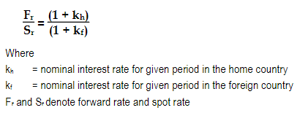
Interest Rate Parity (IRP)
Relationship between spot rate and forward rate is determined by IRP
Investment abroad is affected by ROI on itself and fluctuation in exchange rate
IRP specifies that investors should expect to earn the same return in all countries after adjusting for risk
Example Problem:
Suppose that the interest rate on 180 days government bond is 2 percent in India. The spot exchange rate and forward exchange rate is Rs. 1.60 and Rs. 1.62 per Indian currency (IC) between Nepal and India respectively.
What should be the expected rate of return in Nepal as per interest rate parity
What does the extra return indicate?

Slide 13
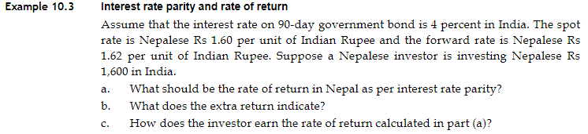
Interest Rate Parity

Slide 14

Purchasing Power Parity (PPP)
PPP is based on an extension and variation of the “law of one price” as applied to the aggregate economy
PPP theory of exchange rate argues that exchange rate movements primarily reflect difference in inflation rates between countries
Exchange rate must change to adjust to the changes in prices of goods in the two countries
P_{h} = P_{f} × S_{r}
Example Problem:
A trader observes one set of television cost in USA is $350, the same set of television cost in Europe € 575. If purchasing power parity holds, what is the spot exchange rate between the euro and the dollar?

Slide 15
Inflation, Interest Rates and Exchange Rates
Relative inflation ( inflation in foreign countries compared with that in home country)
Relative inflation rate influence the production costs at home and abroad
Exchange rate between home currency and given foreign currency rises with higher inflation
Nominal interest rate = Real interest rate + inflation rate
 | Inflation Rate
 | High | Low
Interest | Increase | Decrease
Purchasing Power of currency | Decrease | Increase

Slide 16
International Money and Capital Market
Investing in the foreign markets is the one facet of the international financial markets
Another facet of international financial markets is the financing
International Credit Markets:
Eurocredit (rate tied to LIBOR)
Eurodollar (US dollar deposited in a bank outside the USA)
Euro Bond (international bond underwritten by an international syndicate of banks and sold to investors in countries other than one in whose money unit the bond is denominated)
Foreign Bond (international bond issued in domestic capital market of the country in whose currency the bond is denominated and underwritten by investment banks from the same country)

Slide 17
International Capital Budgeting
International capital budgeting decision is different from domestic capital budgeting in following respects:
Tax laws Differences and Government Restrictions
Cashflow
Political Risk
Exchange Rate Risk
International Capital Structure
No uniformity in the measurement of capital structure.
Difficult to compare the capital structure across the countries due to the use of different accounting conventions.

Slide 18
International Monetary Terminology
An exchange rate
A spot exchange rate
A forward exchange rate
A fixed exchange rate
A floating or flexible exchange rate
A Devaluation or revaluation of a currency
Depreciation or appreciation of a currency
A soft or weak currency

